Slide 1
FNR 59800-018 Intro to R Programming
PFEN 202
Mon, Tue, Thu 8:30-12:20; Fri 12:20-2:20

Slide 2
Day 1 plan
Syllabus/course info
Project Info
Introduction to R
Basic R operations and reading in data
Manipulating data exercise
Begin projects

Slide 3
Course Info

Slide 4
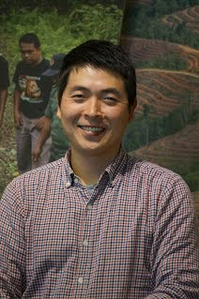
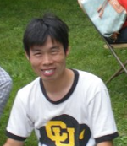


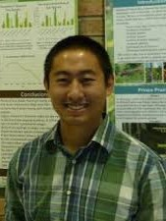
Instructors – The Fei Lab (FORS 204)
Dr. Insu Jo (Post-doc)
jo23@purdue.edu
Research: Invasive species traits
Dr. Anping Chen (Post-doc)
chen2569@purdue.edu
Research: Forest biodiversity modeling
Emily McCallen (5th year PhD candidate)
emccall@purdue.edu
Research: Hellbender salamander conservation
Gabby Nunez-mir (5th year PhD candidate)
gnunezmi@purdue.edu
Research: Beta diversity-invasion relationship
Jon Knott (3rd year PhD student)
knott1@purdue.edu
Research: Species response to climate change

Slide 5
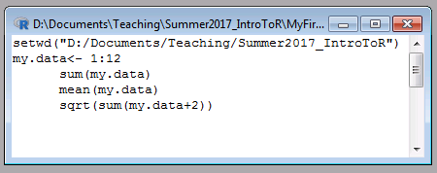
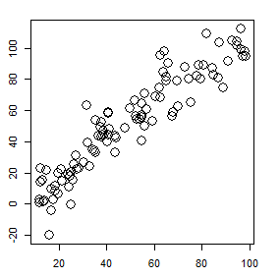
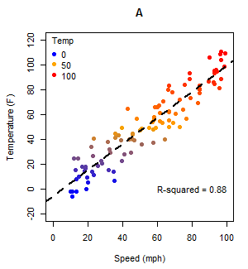
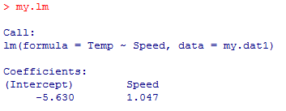
Course schedule/ topics
Day 1 (Mon): Introduction
Lecture: Jon, Anping
Day 2 (Tue): Data exploration and visualization
Lecture: Emily, Insu
Day 3 (Thu): Basic analysis
Lecture: Gabby, Anping
Day 4 (Fri): Project presentations

Slide 6
Open Labs
Feel free to come in during open lab time for help with exercises or projects
PFEN 202
Wednesday – 8:30 – 12:20
Friday – 8:30 – 12:20

Slide 7
How this class works
All course materials available on Blackboard
We’ll keep the lectures short, give time to work through code together
~2 hours lecture/practice
Daily exercises
Answer some questions using R and submit your code: ~1 hour
The final ~1 hour to work on projects

Slide 8
Grades
Attendance is necessary (It’s only a 4-day course)
In case of an emergency absence, please let us know.
100 pts/day for exercise code/questions x 3
200 pts for projects
500 pts total
Since this is a 1 credit course, it will be graded (not pass/fail)

Slide 9
Exercise & Project Info

Slide 10
Exercise info
Five questions per exercise per day
20 points per question x 5 = 100 points per exercise
3 exercises = 300 points total
Turn in to Blackboard by the beginning of the following class:
R file (filename.R) with annotated code
Word document with answers to questions, relevant output
Save files as LastName_Exercise# (e.g. Knott_Exercise1.R)
Grading (per question):
10 points for fully and correctly answering the question
5 points for clarity, annotations, organized code
5 points for code running without errors

Slide 11
Project info
Short, simple research project
Integrates most of the topics discussed, and digs deeper into online help and other resources
8 minute presentation on the last day of class (Fri, 12:30-2:20)
Grading:
40 pts – research question, dataset, documentation
60 pts – project presentation
100 pts – fully functional code
Total: 200 pts
Upload to Blackboard by start of class Friday:
R file with annotated code
Copy of presentation (PowerPoint/Google slides/Prezi)
Any supporting information (datasets, etc.)

Slide 12
Project timeline
Day 1 (Mon): Meet with instructors, discuss project plan, begin project
Day 2 (Tue): Project work , help from instructors
Day 3 (Thu): Project work, prepare presentation
Day 4 (Fri): Presentation
Additionally, instructors will be available in this room if you need help with projects (or exercises):
Wed, 8:30-12:20
Fri, 8:30-12:20

Slide 13
Project example
Data: Forest inventory data and plot environmental conditions
Question: How does species abundance vary based on environmental conditions?
Analysis:
Plotting species abundance between sites of different conditions (i.e. temperature, precipitation, etc.)
Testing linear regression of abundance as a function of temperature or precipitation
Output:
Graphs of abundance across environmental gradients
Regression test results
Code
Presentation

Slide 14
Introduction to R

Slide 15
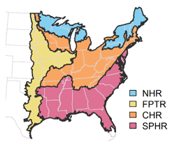
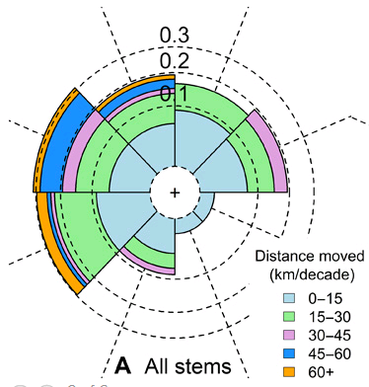
What is R?
R is a computing language for statistics
Based on the language S and S plus
Can be used for graphics, GIS, and others
It’s free and open source
Write your own plug-ins (called packages)
Link to other open source programs (such as Python, QGIS, and others)

Slide 16



Why use R?
R is free, other stats programs aren’t
Some are free through Purdue, but R is free no matter where you end up!
R is common in academia
SAS still used by the government
Recently, FDA and other gov’t organizations using R
Sharable, reproducible science
Some publishers require/highly recommend supplementary R code
Collaborate with people who can’t use paid software
$0.00
>$3000.00
$99.00

Slide 17
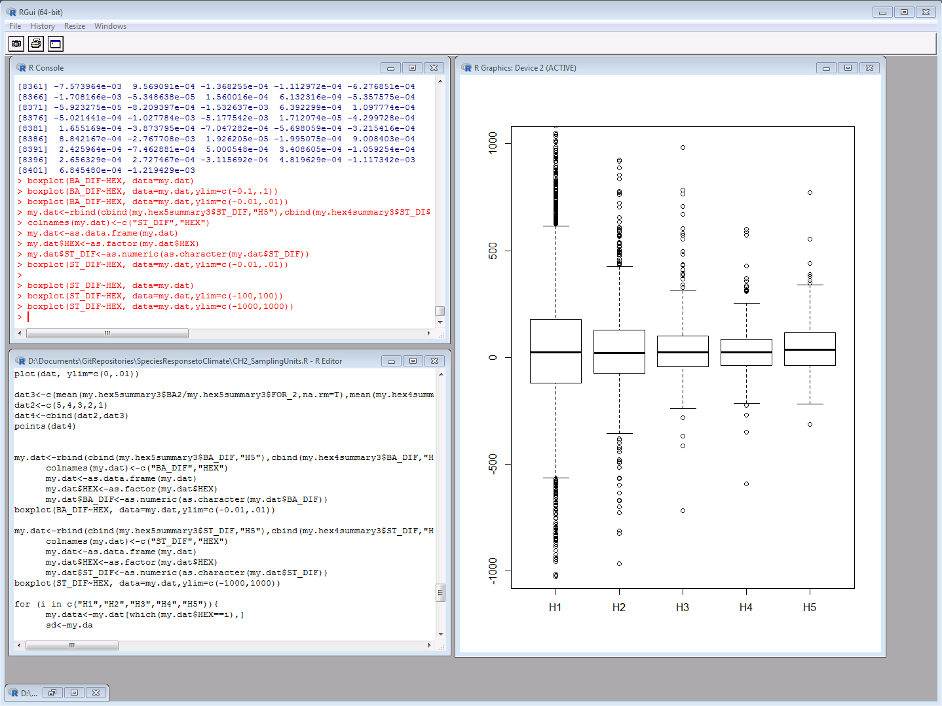
R vs. R studio
R is also a Graphical User Interface (GUI)
Window where you can write and run code, view output, install packages, etc.

Slide 18
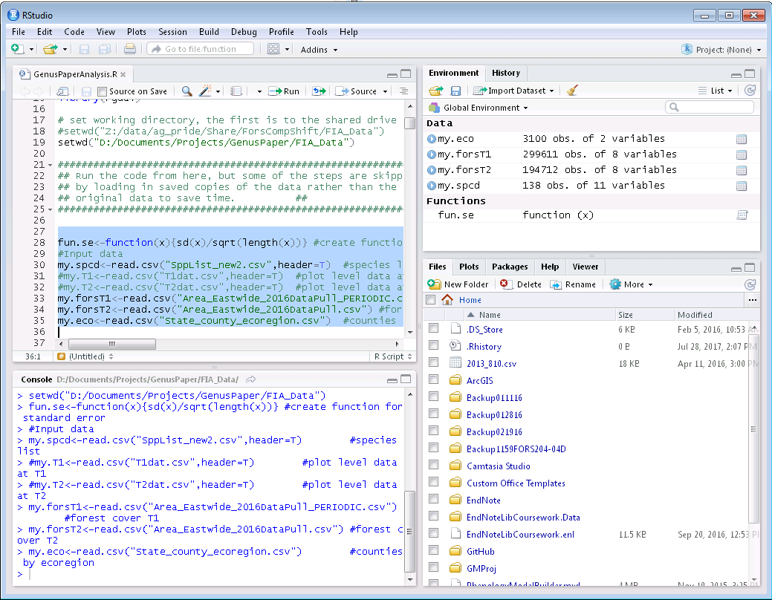
R vs. R studio
R Studio is a Integrated Development Environment (IDE)
Includes everything the basic R GUI has, but adds additional point-and-click interface, lists of data in use, etc.
Code written in R Studio generally runs in R, but some of the shortcuts it has prevents R from running the code

Slide 19
Installing R
R and R Studio are available online free
R: cran.r-project.org
R Studio: www.rstudio.org/products/rstudio
You all should have gotten an email about installing R Studio if you’re using a personal laptop
If not, install R Studio now

Slide 20
Where to find help?
Google
99% of the time someone has had your problem before
Stack overflow (https://stackoverflow.com/questions/tagged/r)
Quick R (https://www.statmethods.net/index.html)
R-Bloggers(https://www.r-bloggers.com/)
For complex ecology questions, r-sig-ecology email list (https://stat.ethz.ch/mailman/listinfo/r-sig-ecology)
Some of the top ecological statisticians use this, so make sure you’re positive it’s a complex enough problem to ask!

Slide 21
Getting Started

Slide 22
R code structure
Case sensitive
MyData is not the same as mydata
Extra spaces don’t matter
col = 10 and col=10 are the same
Most names for things are available
Some function names are taken, such as max or e
You can add “my.” before such as my.max
Quotes are used for character strings
main = “My Title”: the words “My Title” are the title
vs. main = MyTitle: the words stored as MyTitle are the title

Slide 23
R code structure
Assign objects with <- or =
most people use <-
my.num<-12 or my.num=12
# blocks off code for comment or to prevent a line from running
Ctrl+r to run line(s) of code on Windows, Command+Enter on Mac
Highlight multiple lines to run at once
?function() pulls up the help page for the function

Slide 24
Create a script
You can type right into the console to run commands
Good for quick checks
Create/save a script to save your work
Ctrl+n or use the menu to create a new script.
Add a header using a comment (#) to remind you what the code is for without having to run it.

Slide 25
Basic Math
Basic math functions as you’d expect
1+2
5-3
8*4
9/6
7^2
But some need a function
sqrt(16) = square root
exp(2) = e^2
abs(-20) = absolute value of -20

Slide 26
Assigning objects
Use <- or = to save your answer
Most people use <-
my.num <- 3+4
my.num2 <- 4*6
my.num3 <- my.num/my.num2

Slide 27
Types of numbers
Integer vs. double
Integers = whole numbers, double = decimals
my.num <- 2
is.integer(my.num): TRUE
my.num <- 3.4
is.double(my.num): TRUE
Numbers sometimes stored as characters (text)
my.num<-”3”
is.character(my.num): TRUE
as.numeric(my.num): 3

Slide 28
Types of data
Lots of data types in R
Numeric (double)
Integer (whole number)
Character (text)
Factor (category, stored as a number)
E.g. “Temperate”, “Arid”, “Tropical” could look like text but be a factor stored as Temperate = 1, Arid = 2, Tropical = 3
Ordinal (ordered factor)
E.g. “Low”, “Med”, “High” where Low<Med<High

Slide 29
Making numbers
Use a colon between two numbers to make integers
1:6 gives 1, 2, 3, 4, 5, 6
Use seq() to make double
seq(from=1, to=6)
Add by=2 (or any number) to make it skip
seq(from=1, to=6, by=0.5)
Use rep() to repeat
rep(1,5): repeat 1, 5 times
rep(“Hello”,3): repeat “Hello” 3 times

Slide 30
Making random numbers
Use sample() to get random integers
sample(1:20,5,replace=F): sample 5 times from 1 to 20 without replacement
Use runif () (Note: that’s random uniform not run if) for random numbers (not integers)
runif(5, min=0, max=10): 5 random numbers between 0 and 10
Use rnorm() for random numbers from the normal distribution
rnorm(5,mean=0,sd=1)

Slide 31
Vectors
Vectors are 1-dimensional data
They only contain one type of data
i.e. only character or only number
R will convert to whichever data type it can, usually character
Use c() to specify a vector
my.vect<-c(1,2,3,4,5)
Or vector() to create a new one
my.vect2<-vector(length=20)
Check the length
length(my.vect)

Slide 32
Matrix
A matrix is 2-dimensional data
They only contain one type of data
i.e. only character or only number
R will convert to whichever data type it can, usually character
Use matrix(nrow=,ncol=) to create a matrix
Use dim(matrix) to see the size
Use colnames(matrix)<-c(“name1”,”name2”) to set the column names

Slide 33
Data frame
Data frames are like matrices
2-dimensional data
They can contain multiple types of data
The easiest way to make a new data frame is to convert a matrix
as.data.frame(matrix(nrow=2,ncol=3))
Each column is an individual vector

Slide 34
Reading in existing data

Slide 35
Setting working directory
Your working directory is where R looks for and saves data
Usually is a folder on your computer
Use setwd() to set the working directory
setwd(“D:/Documents/Teaching/IntroR”)
Notice R uses “/” not “\” like when you copy a file location from Windows

Slide 36
Reading in data
Commonly, data stored in Excel
From Excel, save as Comma Separated Values (.csv) file
In R, use read.csv() to read in the data
Make sure you assign it!
Use header=T if the first row has column names
My.trees <- read.csv(“treesR.csv”,header=T)
Use read.table for general table types, such as tab separated
Read.table(“treesR.csv”,header=T,sep=“,”)
sep=“,” for comma, “\t” for tab, etc.

Slide 37
View data
If it’s too big to see the whole thing at once, use head() or tail()
head(my.trees,n) pulls up the first n rows
tail(my.trees,n) pulls up the last n rows
As with matrices, use dim() to see the size
Use summary() to give info about the data
Use str() to give info about the data structure
Notice a lot of times text can get read in as factor
Use colnames() to get the column names of the dataset

Slide 38
Select part of the data
Use [rows,columns] after the object name
Leave either blank if you want both
My.trees[,”OAK”]: select my.trees column called “OAK”
My.trees[,4]: select my.trees, column 4
My.trees[4,5]: select my.trees, row 4, column 5
Use [n] after to get the nth element in that column
My.trees[,4][5]: select the 5th element in column 4 of my trees (same as my.trees[5,4])
Use $ in data frames that have column names
My.trees$MAPLE: selects the column called “MAPLE”

Slide 39
Save data
Use write.csv() or write.table() like reading in
Make sure you don’t overwrite an existing file
My.trees2<-my.trees$OAK
Write.csv(my.trees2,“treesR_new.csv”)

